Slide 1
Introduction to ‘Insights to Behavior’
Skills Acquisition Assessment and Management Plan
Presented by: Diane M. Mazzoni, School Psychologist

Slide 2
Agenda
Introductions
Creating an Insights to Behavior Account
Using Insights:
Part I- Add a Student (opening a case)
Part II- Skills Assessment options
Part III-Add Objectives to Identified Deficits
Part IV- Add Activities to Teach Objectives
Part V- Reporting Progress with Graphs

Slide 3
Introductions
Diane Marie Mazzoni
Nationally Certified School Psychologist
Licensed Educational Psychologist
20+ years experience as a District Psych serving preschoolers through adults.
dmazzoni@learnmore.com
559-363-2583

Slide 4
Increase Competency & Capacity
Building Knowledge for Student Success!
Insights
Positive Behavior Support Plan
Mini-Functional Behavior Assessment
Proactive, Replacement Behaviors, & Reactive Strategies that are fully customizable
Build Behavior Plans in as little as 45 minutes
Customizable data collection
Track progress with graphs created instantly by Insights
Insights
Skills Acquisition Plan
Skills assessment across 28 curriculum areas
Over 300 objectives supported by over 5000 activities from the Resources database
Customizable data collection
Track progress with graphs created instantly by Insights
Workshops
Online Training and Professional Development
Introduction to Autism Spectrum Disorder
Improving Social Skills
Introduction to Behavior Management
Improving Learning and Independence
Managing Challenging Behaviors
General Education Topics
Special Topic Series

Slide 5
Account Set Up
Only Sooner Start team members with an active account will be able to use Insights.
There are different levels of access within Insights. Edit (Staff) vs. View Rights Only (family).
URL: www.insightstobehavior.com
(We recommend that you bookmark this site on the computer that you will be using most often)
If you are at a computer please go to Insights now.

Slide 6
FYI: Accounts
Account types:
CMS Owner: Builds and manages cases within Insights, creates reports and enters data - Staff
CMS Data Entry: Views case details and can enter data - Paraprofessionals
CMS Browser: View only - Parents

Slide 7
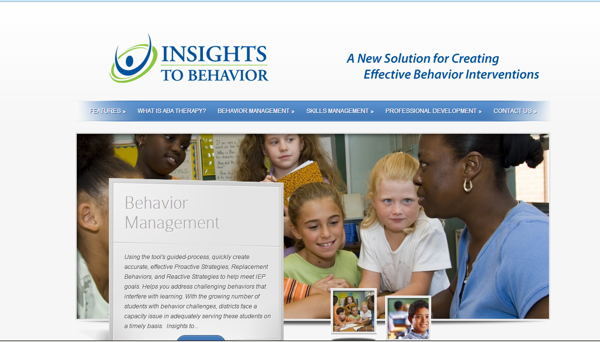
Account Set Up
Scroll Down

Slide 8
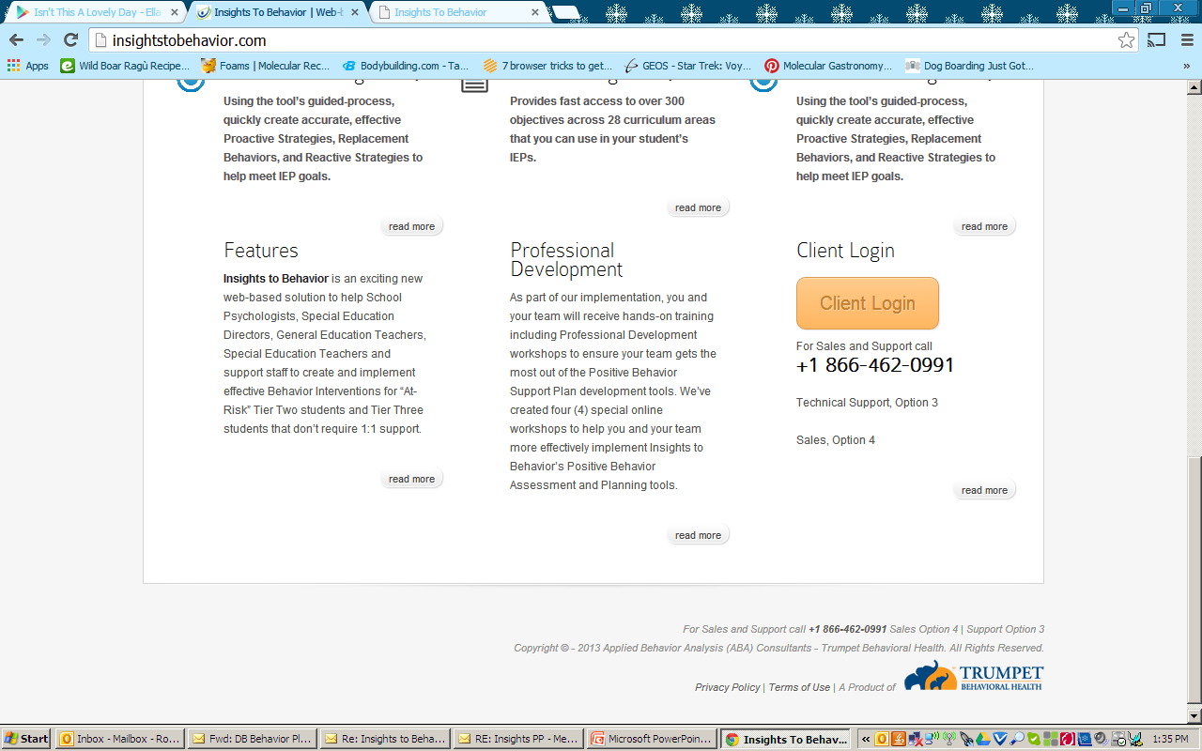
Account Set Up
Click this button

Slide 9
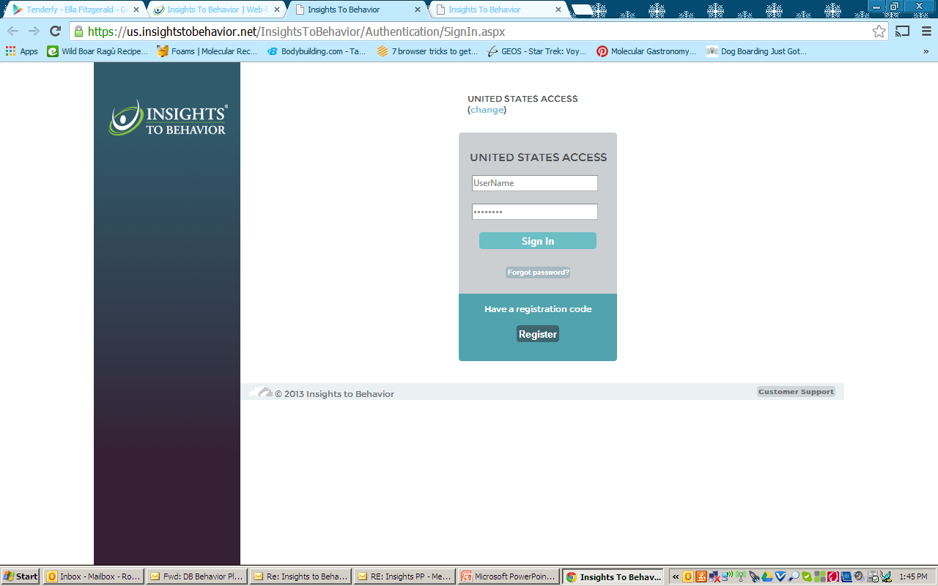
Account Set Up
Click the registration button (you only have to do this one time).

Slide 10
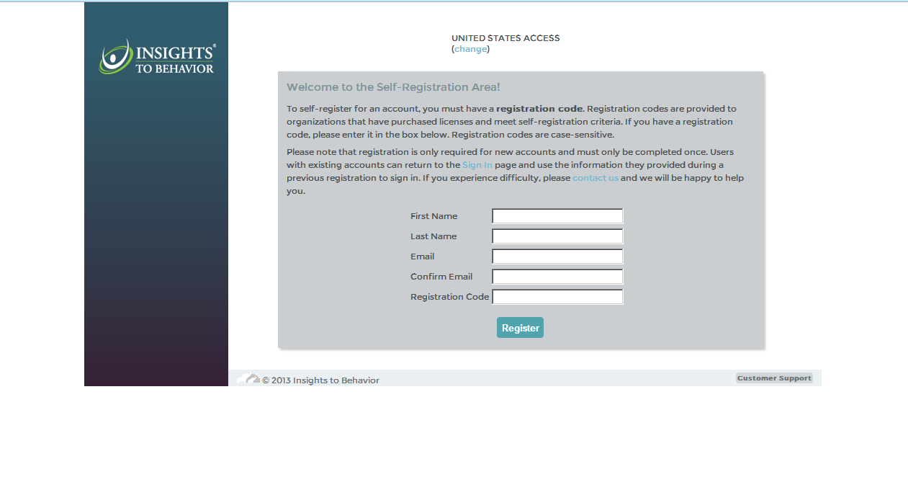
Account Set Up
SoonerStart Emails only

Slide 11
Account Set Up
Use registration code provided by Insights to Behaivor:
Staff: +_+_+_
Family members: +_+_
Notes:
This slide needs to be customized for each district!

Slide 12
Account Set Up
Pick a password with one CAPITAL letter and 1 number.
Please remember your password.
(Most problems logging in are the result of people trying the wrong password).
Accept the license agreement

Slide 13
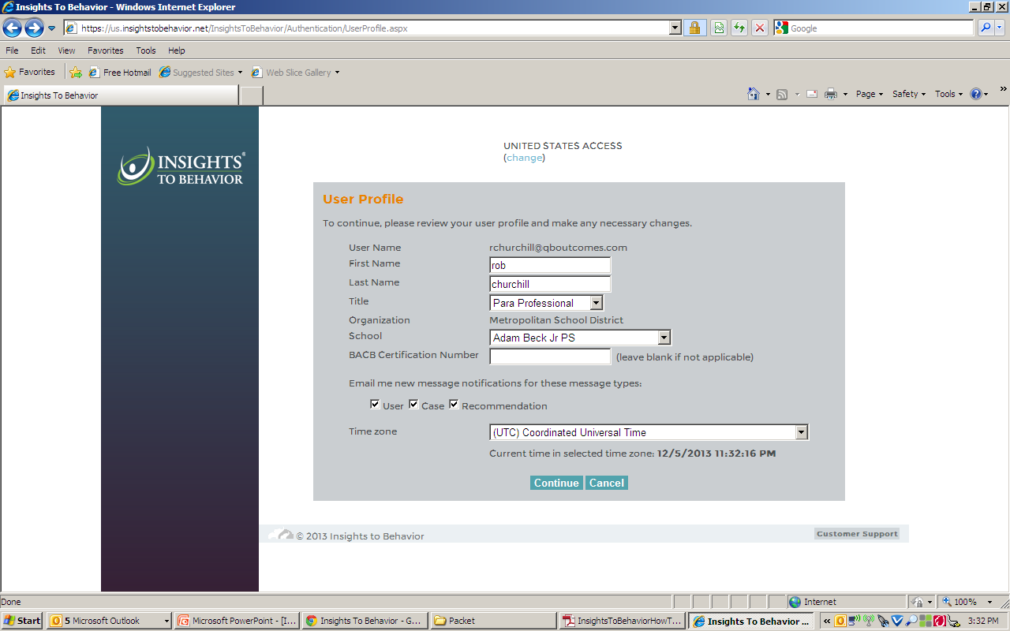
Account Set Up
Select your title and school
If you do not work at the same school each day please choose ‘OUSD Central Office’

Slide 14
Part I-Adding a Student

Slide 15
Adding a Student
Adding a student is also referred to as ‘creating a case’
Insights always give a warning
“Warning: Creating a case will use a case license. Are you sure you wish to continue?”
SoonerStart has an unlimited number of cases.
Only those with ‘Owner’ accounts can open cases.
All participants today are “Owners”

Slide 16
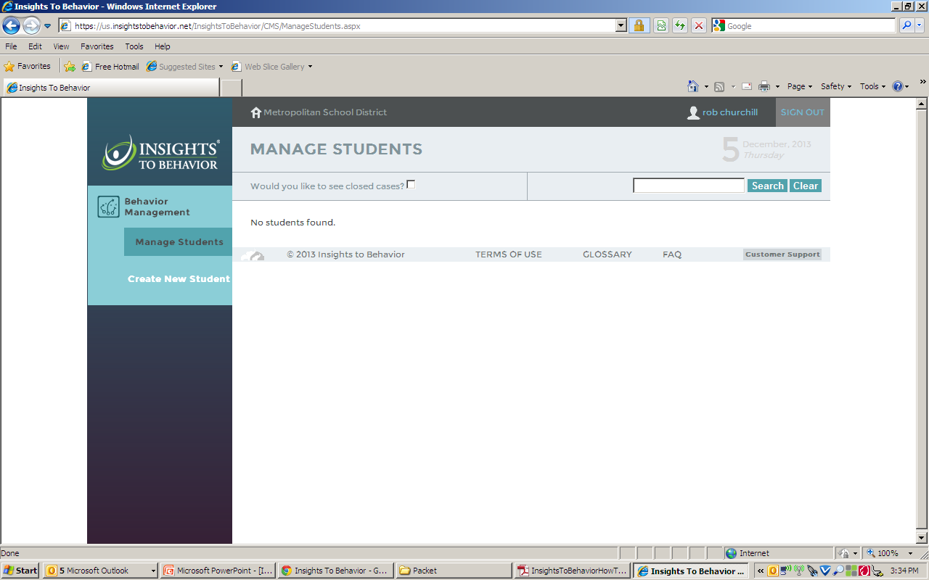
Adding a Student
You are now ready to build your first case in Insights!
Click here

Slide 17
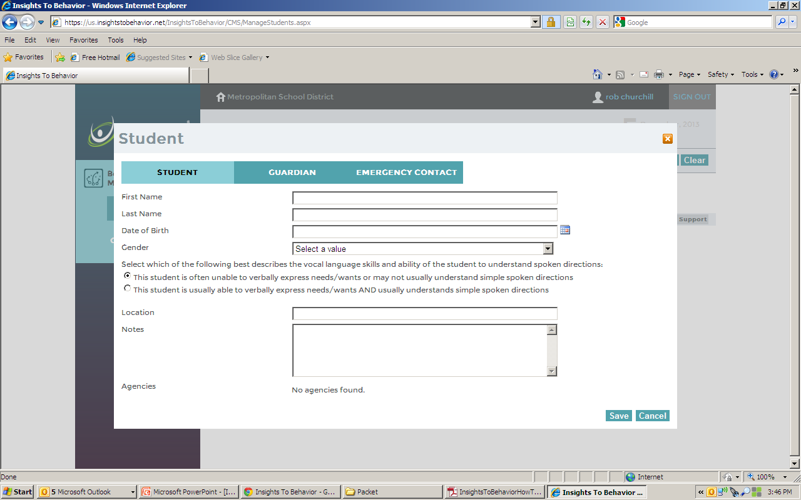
Adding a Student
These 2 tabs can be used if you like but are not required. You can always go back and fill them in at a point in the future
Add name, DOB & gender here
Answer this carefully. Student should be almost completely non-verbal to say that the are unable to speak
School
Misc. info can go here. E.g., meds, etc.
SAVE

Slide 18
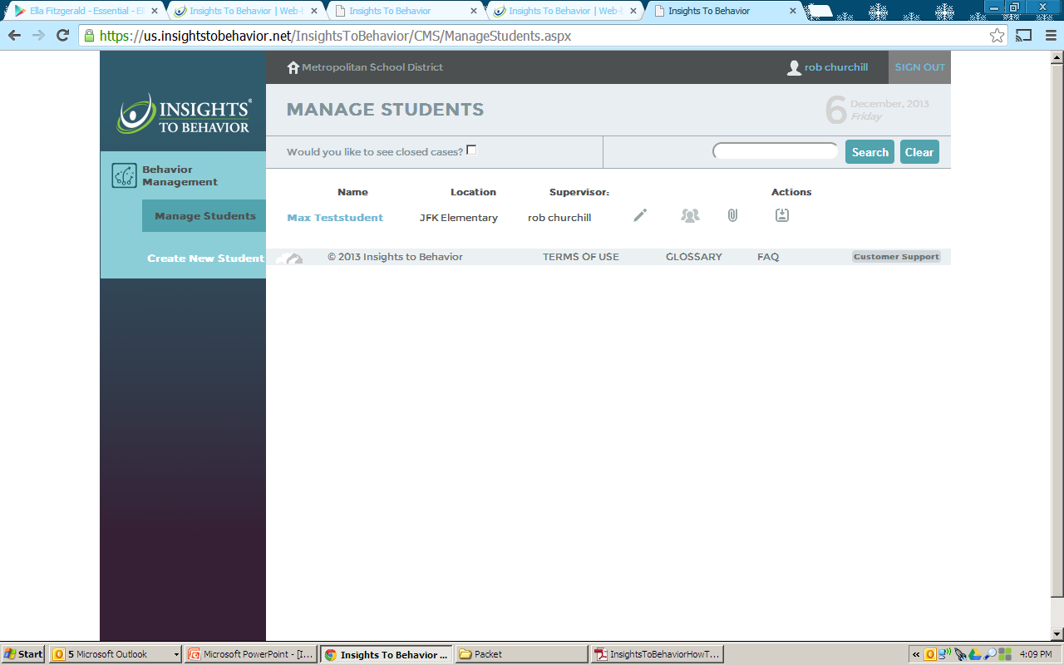
Adding a Student
This button closes cases-NO!!!!
All students you have added will be listed here
Use this button to add team members-you can add anyone who already has an account.-Otherwise contact us to create an account

Slide 19
Part II-Building a Case

Slide 20
Building a Case
Now you are ready to start adding information to this student’s case so you can build a Skills Acquisition Plan.
Click on the student’s name to begin loading information.

Slide 21
Manage Students – Your Caseload
Click on the Student’s Name to Begin Skills Plan

Slide 22
Skills Plan
Click Skills Plan

Slide 23
Skills Acquisition Plan
Task Choices:
* Skills Assessment
Or
* Add Specific Objectives
Skills Assessment will prompt menu driven questions through all Domain Areas, assessing the ‘Whole Child’ resulting in Skill Deficits for each domain

Slide 24
SKILLS DEVELOPMENT

Slide 25
Skills Assessment
Click NEXT after each question

Slide 26
Skills Assessment
The entire Skills Assessment length depends on the developmental level of child
Average length is 45 minutes
You can go back by hitting the ‘Previous’ button to change your answers
Questions are Developmental in Nature and are prompted in order
Answers determine the Skills Acquisition Management Plan, so accuracy is important

Slide 27
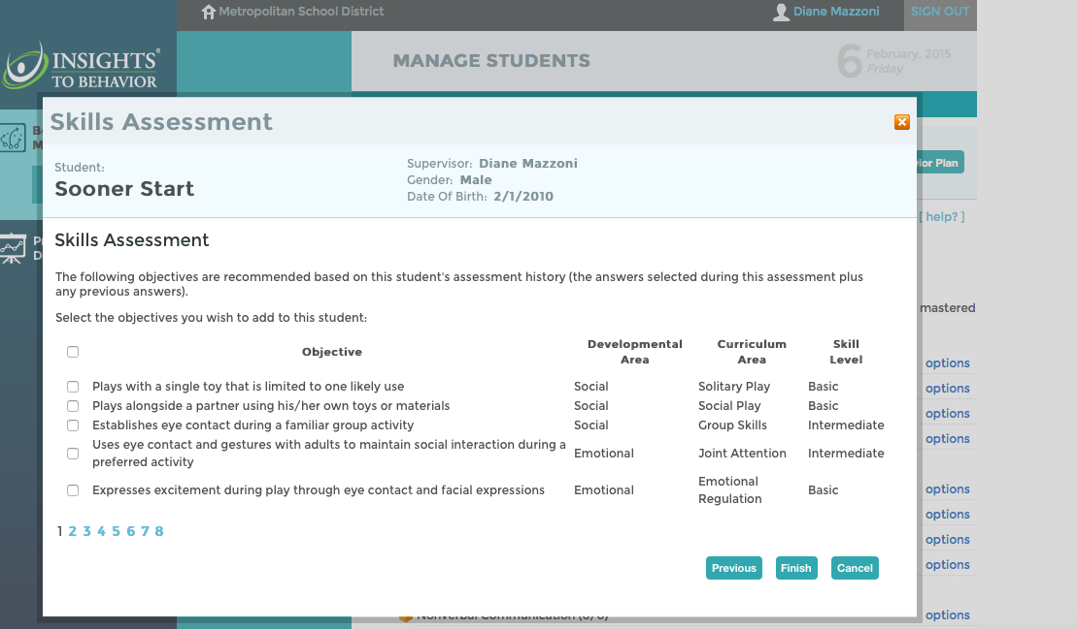
Assessment Results: Objectives
file:///.file/id=6571367.5152705
Objectives are Skill Deficits the Child has NOT yet Mastered, based on the answers from Skills Assessment
Click on page to see objectives

Slide 28
Choosing Objectives for the Plan
After completion of the Developmental Skill Assessment, Objectives are provided, which are skill deficits the child has NOT yet Mastered
Choose those one or two objectives in several Developmental Areas
Too Many objectives may decrease fidelity
You can click the box to the left of the objective to add to current Skills Acquisition Plan

Slide 29
Choose appropriate objectives
Click Finish AFTER adding all objectives
Choose Objectives for all pages

Slide 30
Skills Plan
Click CLOSE to see the Skills Acquisition Plan

Slide 31
Adding Activities to Objectives
Add Activities by Clicking Options to the right of Objective, Click on
‘Add Activities’
Notes:
Your objectives are now visible with the lime green boxes to the left with an expanded tree
If you don’t see your objectives – click on the small plus inside the box to the left of the yellow Domain
Add Activities by click options and click on ‘add activities’

Slide 32
Activities Matched to Child’s Needs
Click ‘Guide Me’ to view the Activities Chosen
Click on any activity to see the step by step Instructions
Notes:
The teal Activities are listed – by clicking on any of the specific items, a full description and step by step instructions is provided

Slide 33
Example Activity
Click Printer Icon to easily share
Notes:
The Instructions can be printed as a hand out and will be included in your Reports anytime you utilize the “Report Manager”

Slide 34
Expanded Tree
Click on the small box with the plus,
to the left of the Green Objective to view Activities
Notes:
Now you can see the red Domain – for Communication, the Yellow Nonverbal subdomain where the student has one identified objective; the lime green square identifies the Objective we are working on and the blue box denotes the Activity we have provided to Teach the skill deficit

Slide 35
Print Skills Acquisition Plan
Print
Notes:
We can Print the Skills Acquisition Plan which will identify the objectives and the activities we’ve chosen to teach and practice those skills

Slide 36
Example Report
Scroll down your report to see Activity Instructions
Notes:
These are the identified objectives and below that are the activities for each objective

Slide 37
Part IV-Monitoring the Plan

Slide 38
Monitoring the Plan
Best practices in ABA state that careful ongoing monitoring of behavior is critical to evaluate progress over time.
Without objective measurement of student behavior ineffective programs may persist and effective programs may be rejected
Insights offers an easier way to produce behavioral graphs which can be exported into progress reports for evaluating student progress

Slide 39
Collecting Data
Click ‘Print’ to print blank datasheet to leave with Teacher or Parent
Click ‘Edit’ to change number of Trials (data collection)
Click ‘Enter Data’; click “Details’ to add Individual Trial Responses
Click ‘Modify’ to enter quickly 3/5 for 3 out of five trials

Slide 40
Example: Blank Data Sheets

Slide 41
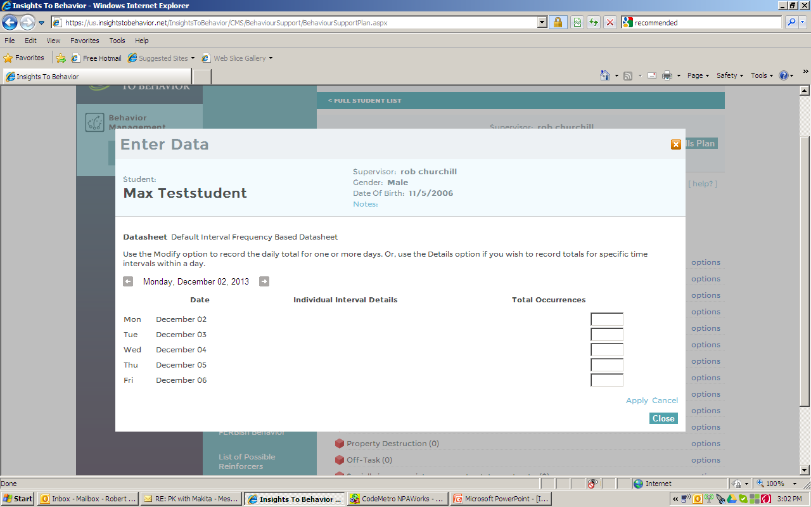
Entering DATA
Choose other weeks by clicking these arrows
Insert the daily totals in the corresponding boxes

Slide 42
Graphs
Click ‘Graphs’ after adding data to Print Graph, click ‘SAVE’ to add to Progress Reports
Rename your Graph for the Skill measured and click ‘Refresh’
Notes:
Click Graphs after you have added DATA - Rename your Graph to the specific skill you are measuring – You may not be measuring every skill in your plan –
But we want to remember what the data represents – use the Objective Skill to guide the name, like “Head nod” is the skill I want the student to learn, so I call it Head Nod
Click Refresh after adding the new name and then SAVE Graph for later use.

Slide 43
Reporting Progress

Slide 44
Reporting Progress
Formal written reports detailing treatment progress is a time consuming yet necessary activity.
Insights can create high quality, detailed reports in a very short time.

Slide 45
Progress Report Manager
Click ‘Progress Report Manager’
Click ‘Create New Report’ and NEXT
Notes:
From the Skills Acquisition Plan Expanded Tree page, click on the ‘Progress Report Manager’ in white letters on the top left hand side of your screen. A pop-up box allows you to create a new report or print or view an old report. Click NEW REPORT and NEXT to create your report.

Slide 46
Report Example with Graphs
Scroll down to the bottom of the Graph Options to see ‘saved graphs’ you wish to include in Reports. Reports can be saved via .pdf
Notes:
You are prompted to title your Report or “name it”, provide dates and are given a box to add notes, comments or additional information you wish to include.
A list of Graphs are provided at the bottom of the screen that you can include in your reports. Scroll down to the bottom, to see the Graphs you have previously saved.
‘check’ the box next to the graphs you wish to include in your report – print and save! You can save a report in a .pdf format to easily email or file as needed.

Slide 47
Questions??
Insights to Behavior, Skill Acquisition Assessment and Management Plan
Support: Diane Mazzoni Phone: (559) 363-2583 Email: dmazzoni@learnmore.com
Thank you!

