Slide 1
Welcome
The Educator’s Role in Curbing Student Anxiety
Presented by Dr. Lynette Thompson

Slide 2
About Dr. Lynette Thompson
Retired after 28 + years in Education
Served as Special Education teacher (ED)
Asst. Director of a Detention facility
Asst. Principal and Principal
Asst . Director of Special Services
Executive Director of Special Services
Executive Director of Educational Services
Dr. Lynette Thompson
Currently serving as the Chief Administration Officer of BRIDGES DBA Oklahoma Family Counseling Centers
“Changing the World One Child at a Time”

Slide 3
Student Anxiety
According to the National Children’s Alliance (2014), 80% of children and teens with Anxiety are not getting the help they need

Slide 4
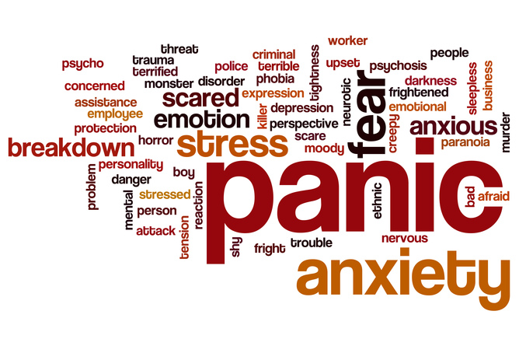
Student Anxiety
In fact, 40 million American adults and according to National Institute of Mental Health 31.9 % of students are affected by anxiety.

Slide 5
Why?
Anxiety can be hard to recognize
Caretakers assume children and teens are just being obstinate or they are spoiled
Anxiety can present itself differently in each student
Adults want to help but don’t know how
Everything that is tried seems to make it worse

Slide 6
Causes of Anxiety:
Genetic: Adolescents who have a first-degree relative who has an anxiety disorder are at greater risk for developing anxiety disorders than those who do not have a similar history.
Physical: Neuroimaging studies showed that teens with anxiety disorders have atypical activity in certain areas of the brain when compared with their peers.
Environmental: Extremely stressful events, such as the death of a loved one, sudden move to a new area, or the divorce of parents, can bring about anxiety disorders. Additionally, when children grow up in a home where others are fearful, it can lead them to believe the world is a dangerous place. Other children who grow up in a dangerous home may also become fearful.
https://www.villagebh.com/disorders/anxiety/symptoms-signs-effects/

Slide 7
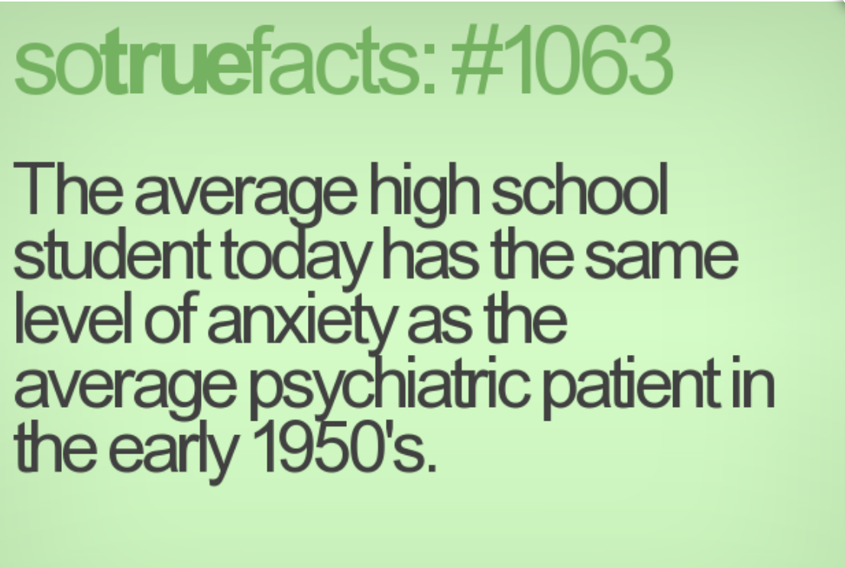
Risk Factors:
Being female
Traumatic events during childhood years
Stress due to chronic illness of a teen or his or her parent
Personalities that are prone to worrying
Usage of drugs or alcohol

Slide 8
Anxiety Disorders Include:
Post Traumatic Stress Disorder
General Anxiety Disorder
Social Anxiety Disorder
Panic Disorder
Obsessive Compulsive Disorder
https://www.ncbi.nlm.nih.gov/books/NBK262332/

Slide 9
Post Traumatic Stress Disorder (PTSD):
Children under 6 may get upset if their parents are not close by, have trouble sleeping or act out trauma during play
Children ages 7-11 may also act out trauma through play, drawings, or stories. Some have nightmares or become more irritable or aggressive. They may also want to avoid school, or have trouble with school work, or friends.
Children ages 12-18 have symptoms more similar to adults: depression, anxiety, depression, withdrawal, reckless behavior like drug abuse or running away. (Learn More)
PTSD: National Center for PTSD

Slide 10
General Anxiety Disorder (GAD)
Excessive anxiety and worry occurring one more days than not for at least 6 months about a number of events or activities
The person finds it difficult to the control the worry.
The anxiety and worry are associated with one (for children) of the following:
1. Restlessness or feeling keyed up or on edge
2. Being easily fatigue
3. Difficulty concentrating or mind going blank

Slide 11
CONT. The anxiety and worry are associated with one (for children) of the following:
3. Difficulty concentrating or mind going blank
4. Irritability
5. Muscle tension
6. Sleep disturbance (difficulty falling to sleep or restless
unsatisfying sleep)

Slide 12
More about GAD
The anxiety is not caused by one of the other Anxiety categories (ex. PTSD)
The Anxiety, worry or physical symptoms cause clinically significant distress or impairment in social, occupational or other important areas of functioning
Not caused by direct effects of substance abuse or a general medical condition does not occur exclusively during a mood disorder, psychotic disorder or pervasive developmental disorder

Slide 13
Social Anxiety Disorder (SAD)
Children and teens with Social Anxiety Disorder have an excessive and persistent fear of social and/or performance situations such as school parties, athletic activities, and more. These children constantly feel “on stage.” Being a quiet or shy child is not the same
Learn more at DSM AnxietyBC

Slide 14
Panic Disorder
“Children and adolescents with panic disorder have unexpected and repeated periods of intense fear or discomfort, along with other symptoms such as a racing heartbeat or feeling short of breath. These periods are called "panic attacks" and last minutes to hours. Panic attacks frequently develop without warning” (AAOCAP, 2013)
Learn more DSM AAOCAP

Slide 15
Chronic Compulsive Disorder
“Obsessive-compulsive disorder (OCD) is a condition that causes kids to have unwanted thoughts, feelings, and fears. These are called obsessions, and they can make kids feel anxious. To relieve the obsessions and anxiety, OCD leads kids to do behaviors called compulsions (also called rituals)” (Kids Health, n.d.)

Slide 16
Obsessions
Fears that kids with OCD can’t stop thinking about. They may realize their thoughts don’t make sense, but they still feel anxious about certain things.
Learn more at Kids Health Learn more at DSM

Slide 17
Compulsions
“Compulsions (rituals) are behaviors that kids with OCD do repeatedly. OCD causes kids to feel they have to do rituals to "make sure" things are clean, safe, in order, even, or just right. To kids with OCD, rituals seem to have the power to prevent bad things from happening” (Kids Health, n.d.).
Learn more at DSM Learn more at Kids Health

Slide 18
What does it feel like?
Anxiety
What having anxiety feels like

Slide 19
Is there anything we can do to help?
Dr. Clark Goldstien authors many articles for the Child Mind Institute and suggests:
Our goal needs not eliminate the anxiety, but to help the student learn to manage it.
Don’t avoid things just because it makes the student anxious
Express Positive- but realistic expectations
Respect his/her feelings, but not empower him/her.
Don’t ask leading questions

Slide 20
Is there anything we can do to help?
Don’t reinforce the child’s fears.
Encourage the child to tolerate his/her anxiety
Try to keep the anticipatory period short.
Think through with the student.
Try to model healthy ways of handling anxiety.
Learn more at Child Mind Institute

Slide 21
Stop Doing
Start Doing
Stop reassuring the student
Don’t tell them it isn’t real
Don’t walk away right after the student has calmed
Instead pause and take deep breaths
Empathize that Anxiety is very scary
Staying with the student to work out possible solutions

Slide 22
Stop Doing
Start Doing
Don’t Feel Guilty
Know that you are trying to give them tools they need to manage their worry.

Slide 23
Practical Strategies
Point out how worrying can be good
Bring a worry to life
Teach the student to “think accurately”
Catch your thoughts; Collect Evidence; Challenge your thoughts
Learn more at gozen

Slide 24
Practical Strategies
Let them go from What if to What is; Let them focus on their breath and then discuss what is
Allow them to worry; but set limits
Have the students, along with your guidance, create a checklist with a step-by-step guide on how to calm down.
Learn more at gozen

Slide 25
Are you the cause?
Adult-induced anxiety
What is it ? Have you ever experienced it?
Learn more at gozen

Slide 26
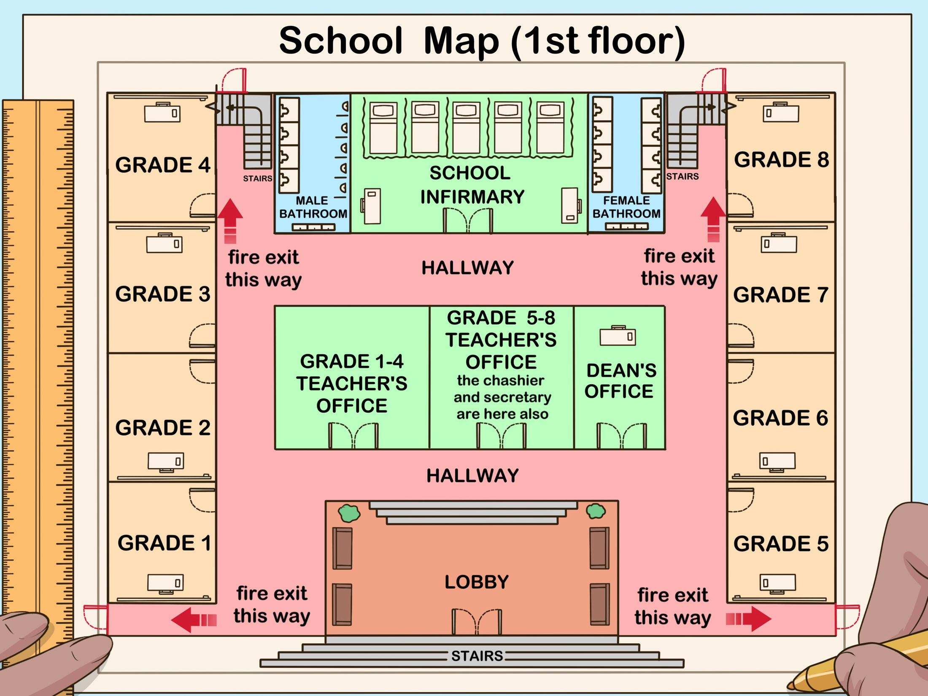
How teachers can create a safe environment for students with anxiety
Allow students to visit the new teacher, classroom or building at the end of the school year for preparation for the next year.
Make picture portfolio of his/her new school teachers etc.
Give students maps or checklist in case of emergency

Slide 27
How teachers can create a safe environment for students with anxiety
Don’t change the routine without letting the students know
Send a letter home to student over the summer reminding him/her of the visit and something you remember in your conversation with him/her.
Expectations are posted and student understands them

Slide 28
How teachers can create a safe environment for students with anxiety
Consistency in your rules and your expectations as a teacher
Remind student days in advance and everyday up to you being absent from the building
Let students practice work and go over it with you prior to having to answer questions or read aloud.

Slide 29
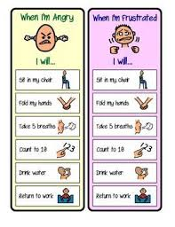
How teachers can create a safe environment for students with anxiety
Have a visual cue if you or the student feels he/she needs to leave the classroom for a calm down period and have perimeters set for this event
Reminders before transitions are coming

Slide 30
Administrators role in creating a safe environment for students
Have the student come to school prior to school starting (not counting the one before summer break) before attending back to school events.
Take an inventory list of items ALL students are comfortable doing or not comfortable doing. (This will give you an idea of who might have anxiety and allow you to be proactive.)

Slide 31
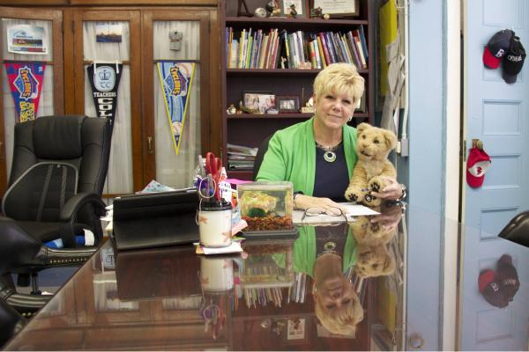
Administrators role in creating a safe environment for students
Be sure students have safe place and a safe person to talk to if needed.
Be sure students know the schedule for the day.
Have teachers check on 5 kids daily
Be prepared for the unknown.. Have a plan for not having a plan.

Slide 32
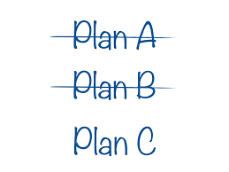
Administrators role in creating a safe environment for students
Reassure them you, as the administrator are in charge, and you are there to keep all students safe and explain how they can get easy access to you.
Explain who is in charge if you absent
If you have a runner, give them a place to run to that is safe and a instructions on when and how this place can be used.
Be sure staff is trained on how to deal with behaviors that often result from anxiety

Slide 33
Is a behavior plan necessary?
How can we teach the student how to regulate their own behavior when anxiety begins to take over?
Do the people in your school know how to write a behavior plan? One that will stand up in court? More importantly– that can change student behavior when students become anxious?

Slide 34
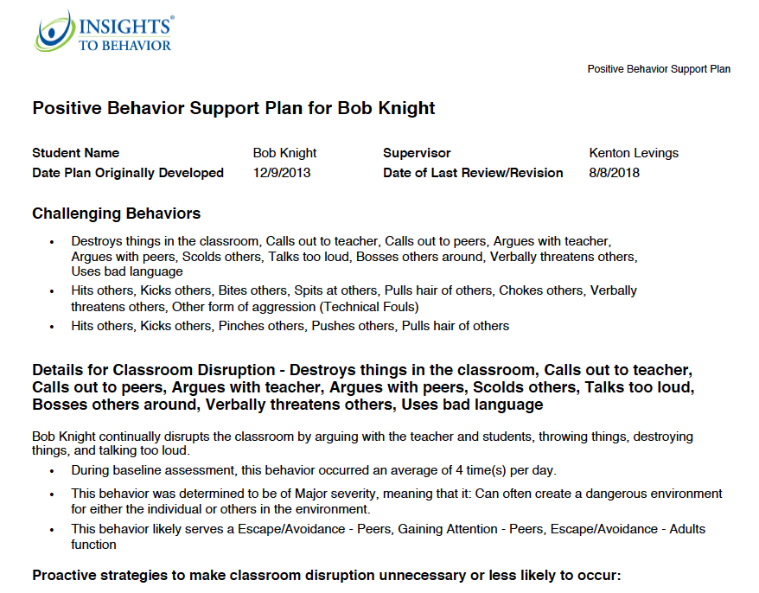
Behavioral Plan
What caused the anxiety to reach a point of causing a negative behavior to occur?
(was she/he trying escape from something or attain something)
What was the antecedent to this episode?
What replacement behavior can we give the student in order to not use a negative behavior?

Slide 35
Ideas for replacement behavior or ways to self-regulate
Take deep breaths
Count to ten
Voice your feelings
Remove yourself to a safe place
Close your eyes and picture yourself in a safe place or with a safe person
Listen to your breathing and slow it down
Ask for help
Call on a friend
Redirect your thinking
Squeeze ball
Listen to music

Slide 36
Can your staff do this on their own?
There are many programs that assist with writing behavior plans however, I would highly recommend Insights to Behavior.
It provides staff who have the ability to write a sound behavior plan a simple and easily accessible program that will insure all components of the plan have been addressed.
Insights walks less-trained staff through step-by-step process covering all essential components of a behavioral plan. In addition, the program provides examples of measurable goals and objectives, in case staff is struggling to create their own.

Slide 37
Can your staff do this on their own?
Professional Development / Training for teachers and paras is embedded in the program.
The format and design will make sure you are prepared for court as well scrutiny from other stakeholders.
The most important aspect of the program-- these well-written plans will assist students in reshaping behaviors and overcoming their anxiety.
Extra Bonus: Decrease your anxiety, your staff’s anxiety and your attorney’s anxiety!

Slide 38
Questions?

Slide 39
Thank you for attending
Dr. Lynette Thompson
“Changing the World One Child at a Time”
If I can answer questions or be of any assistance, you can reach me at
dr.lthomp@gmail.com

Slide 40
Resources
https://www.anxioustoddlers.com/signs-of-social-anxiety/#.W3mtSuhKiM8
https://adaa.org/living-with-anxiety/children/school-refusal
https://childmind.org
https://www.aacap.org/.../Panic-Disorder-In-Children-And-Adolescents-050.aspx
https://www.anxietybc.com
www.worrywisekids.org/

